Slide 1
Neural Networks &
Genetic Algorithms
Bujor Pavaloiu

Slide 2
Content
1. Artificial Intelligence, Machine Learnig, Connectionist paradigm
2. McCulloch & Pitts neuron model. Perceptron
3. Adaptive Linear Neurons
4. Feed-Forward Neural Networks, Backpropagation
5.,6. Deep Learning
7. Competitive learning Kohonen SOMs
8.,9.,10 Genetic Algorithms
11. Hopfield Networks
Neural Networks & Genetic Algorithms

Slide 3
Hopfield Networks
In the beginning of the 1980s Hopfield published two scientific papers, in which he showed that models of physical systems could be used to solve computational problems.
Hopfield networks could be implemented in hardware by combining standard components such as capacitors and resistors.
Hopfield networks are typically used for classification problems with binary pattern vectors.
Neural Networks & Genetic Algorithms

Slide 4
Associative Networks
Hopfield networks are also called associative networks since they associate a class pattern to each input pattern.
In an n-dimensional data space, class patterns should have n binary components {1,-1}; that is, each class pattern corresponds to a corner of a cube in an n-dimensional space.
The network is then used to classify distorted patterns into these classes. When a distorted pattern is presented to the network, then it is associated with another pattern. If the network works properly, this associated pattern is one of the class patterns.
Neural Networks & Genetic Algorithms

Slide 5


The units in Hopfield nets are binary threshold units.
The value is determined by whether or not the units' input exceeds their threshold.
Hopfield nets can either have units that take on values of 1 or -1,
or units that take on values of 1 or 0.
Neural Networks & Genetic Algorithms

Slide 6
w_{ij} is the strength of the connection weight from unit j to unit i (the weight of the connection).
s_{j} is the state of unit j.
θ_{i} is the threshold of unit i.
The connections in a Hopfield net typically have the following restrictions:
w_{ii} = 0 for any i - the units are not connected with themselves
w_{ij} = w_{ji} for any i and j - connections are symmetric
Neural Networks & Genetic Algorithms

Slide 7
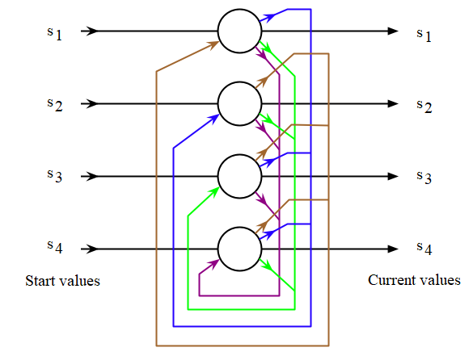
Hopfield NN with 4 units
Neural Networks & Genetic Algorithms

Slide 8
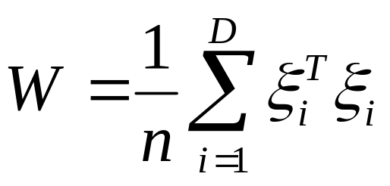
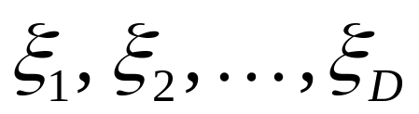
Weights of Hopfield Networks
Hopfield network types have a matrix of weights W that can be defined as
where D is the number of class patterns
vectors consisting of +1, -1 elements, to be stored in the network,
and n is the number of components (the dimension) of the class pattern vectors.
Neural Networks & Genetic Algorithms

Slide 9
Discrete-time Hopfield Networks
The dynamics of the network is given by:
x(t + 1) = Sign [W x(t)].
The network converges when:
x(t + 1) = Sign [W x(t)] = x(t) .
A distorted pattern, x(0), is used as initial state for the dynamics equation, and the associated pattern is the state toward which the system converges.
The energy of a vector x is given by:
E(x) = - x W x^{T}
Neural Networks & Genetic Algorithms

Slide 10
Energy of Discrete Networks
It can be shown that, for any initial state vector x(0), the system converges to a state x(t) having a minimum energy E(x) = - x ^{T}W x.
Hence, the minima of E(x) constitute possible convergence points of the Hopfield network.
Ideally, these minima are identical to the class patterns ξ1, ξ1, …., ξD
Hence, one can guarantee that the Hopfield network will converge to some pattern, but one cannot guarantee that it will converge to the right pattern.
The energy can take negative values, but this is just a matter of scaling. Adding a sufficiently large constant to the energy, it can be made positive.
Neural Networks & Genetic Algorithms

Slide 11
Advantages
Hopeld networks can provide
Associations or classications
Optimization problem solution
Restoration of patterns
In general, as with perceptron networks, they can be viewed as mapping networks
Neural Networks & Genetic Algorithms

Slide 12
Hopfield Network with 2 vectors to learn
1
1
1
X1=
Learn ternary 2 vectors:
[1, [-1,
1, and -1,
1] -1]
0 | 1 | 1
1 | 0 | 1
1 | 1 | 0
W=
-1
-1
-1
X2=
1
1
1
1
1
1
Neural Networks & Genetic Algorithms

Slide 13
Hopfield Network with 2 vectors to learn
-1
-1
1
-1
1
-1
-1
1
1
1
-1
-1
1
-1
1
1
1
-1
2
-1
-1
-1
1
1
1
-6
Neural Networks & Genetic Algorithms

Slide 14
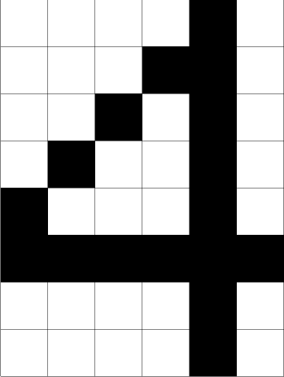
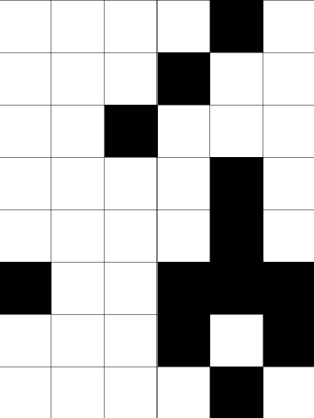
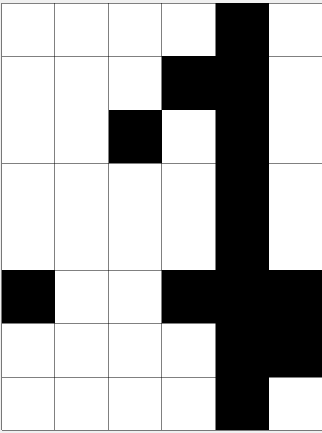
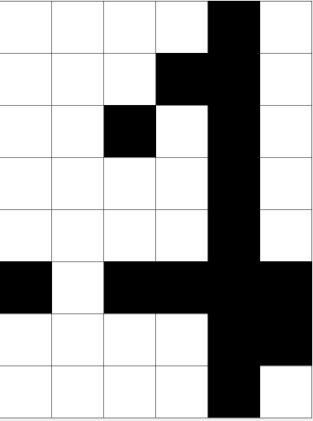
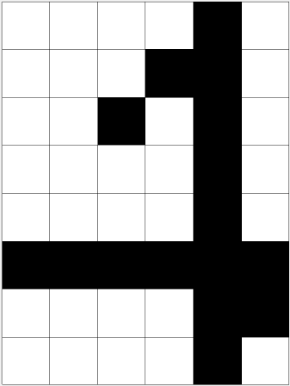
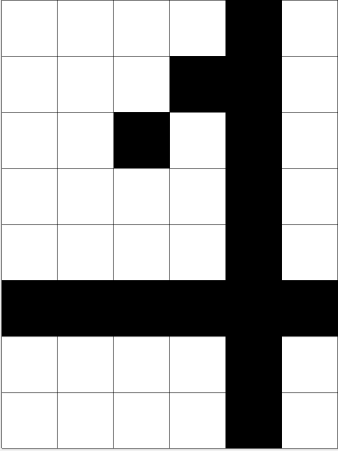
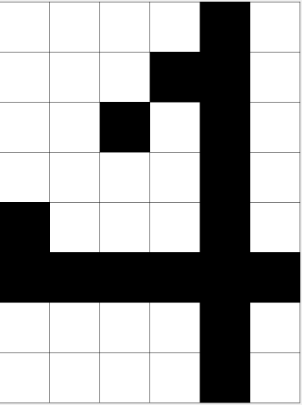
Example – Digit Recognition
Switch
pixels
Neural Networks & Genetic Algorithms

